Slide 1
Is Peace Possible? The World Beyond War Campaign by Russ Faure-Brac Chico State University February 19, 2014
Notes:
----- Meeting Notes (2/11/14 15:04) -----
How many think peace is possible?
----- Meeting Notes (2/11/14 15:07) -----
Father Furious
Brother Khe Sahn
Marching on weekends
----- Meeting Notes (2/11/14 15:10) -----
Father furious

Slide 2
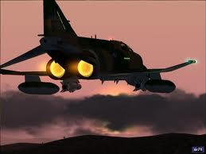
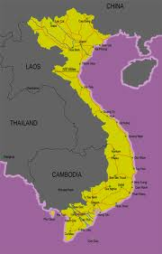
Stanford Research Institute
Notes:
Father Furious, Brother fighting Battle of Khe Sahn. Feared for his safety. Damned the war that put him there.
How many think possible, impossible…?
In searching for the answer, I had AHA moments

Slide 3
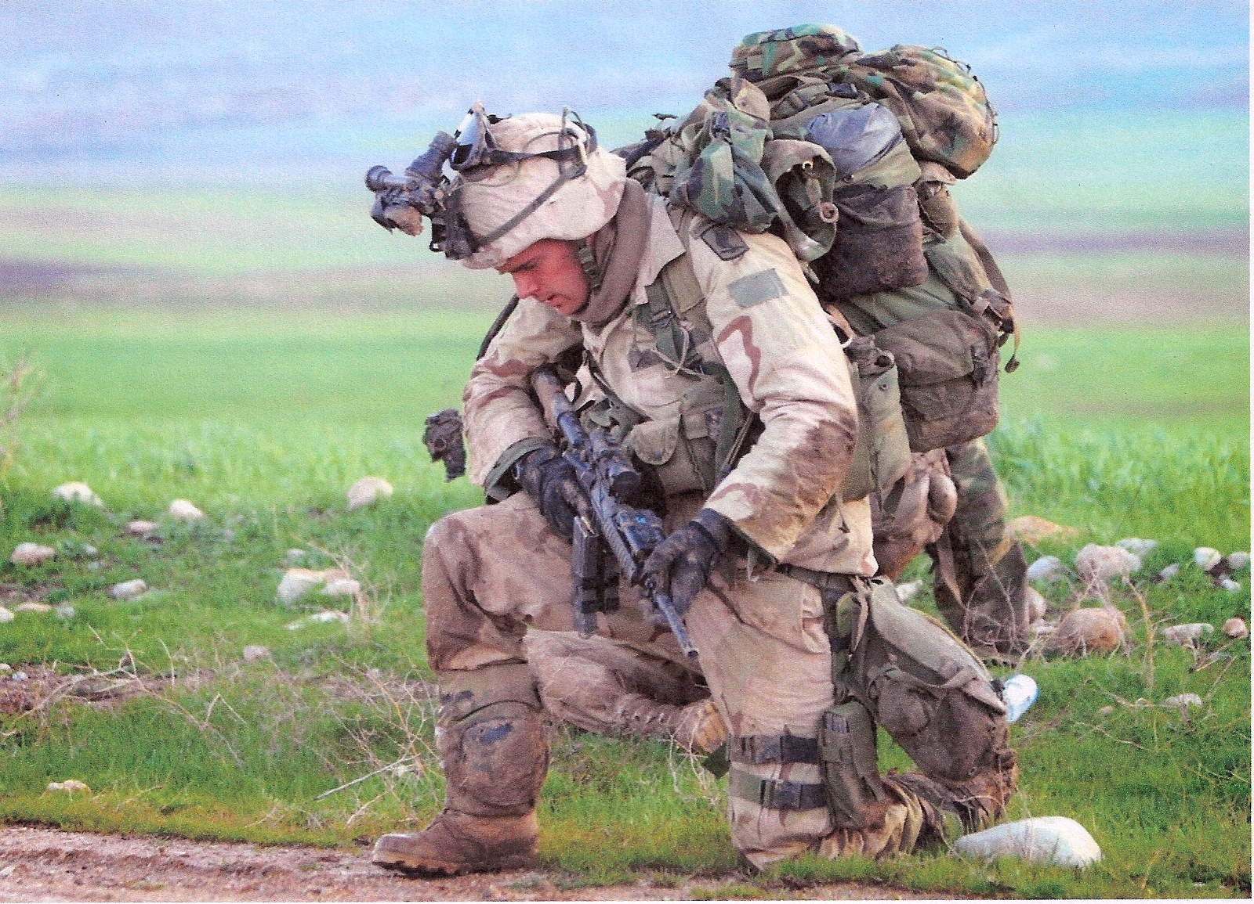
Part 1 Reflections on War

Slide 4
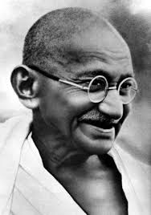
Aha #1 Nonviolence has been used by the oppressed against the oppressor, never by an empire for national defense.

Slide 5
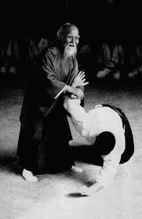
Peaceful Warriorship
Avoidance
Protection
Force as a last resort

Slide 6
Force Continuum

Slide 7
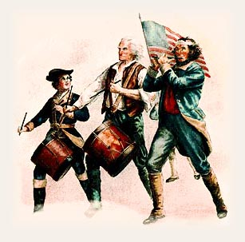
AHA #2 US Major Wars
Notes:
How many do you think?15 Total, 65 incursions, CIA, 17 avg.
1812, Mexican Am., Iraq, Afghanistan

Slide 8
14 (once every 17 years)
1775 American Revolution
1812 War of 1812
1800’s American Indian War
1846 Mexican-American War
1861 Civil War
1898 Spanish-American War
1898 Philippine-American War
1917 World War I
1941 World War II
1950 Korean War
1964 Vietnam War
1990 Gulf War
2001 Afghanistan War
2003 Iraq War

Slide 9
AHA #3 Cost of War
Notes:
What do you think we spend on National Security?

Slide 10
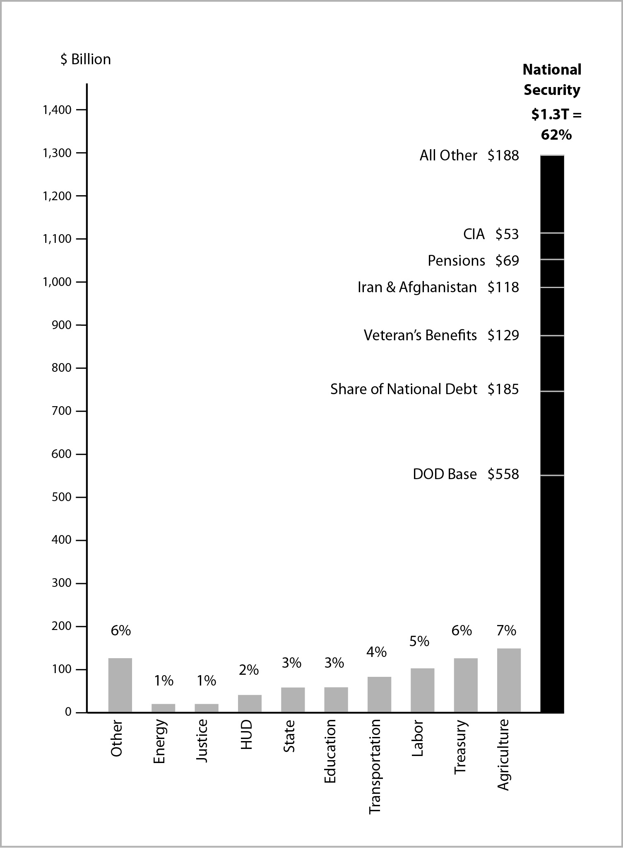
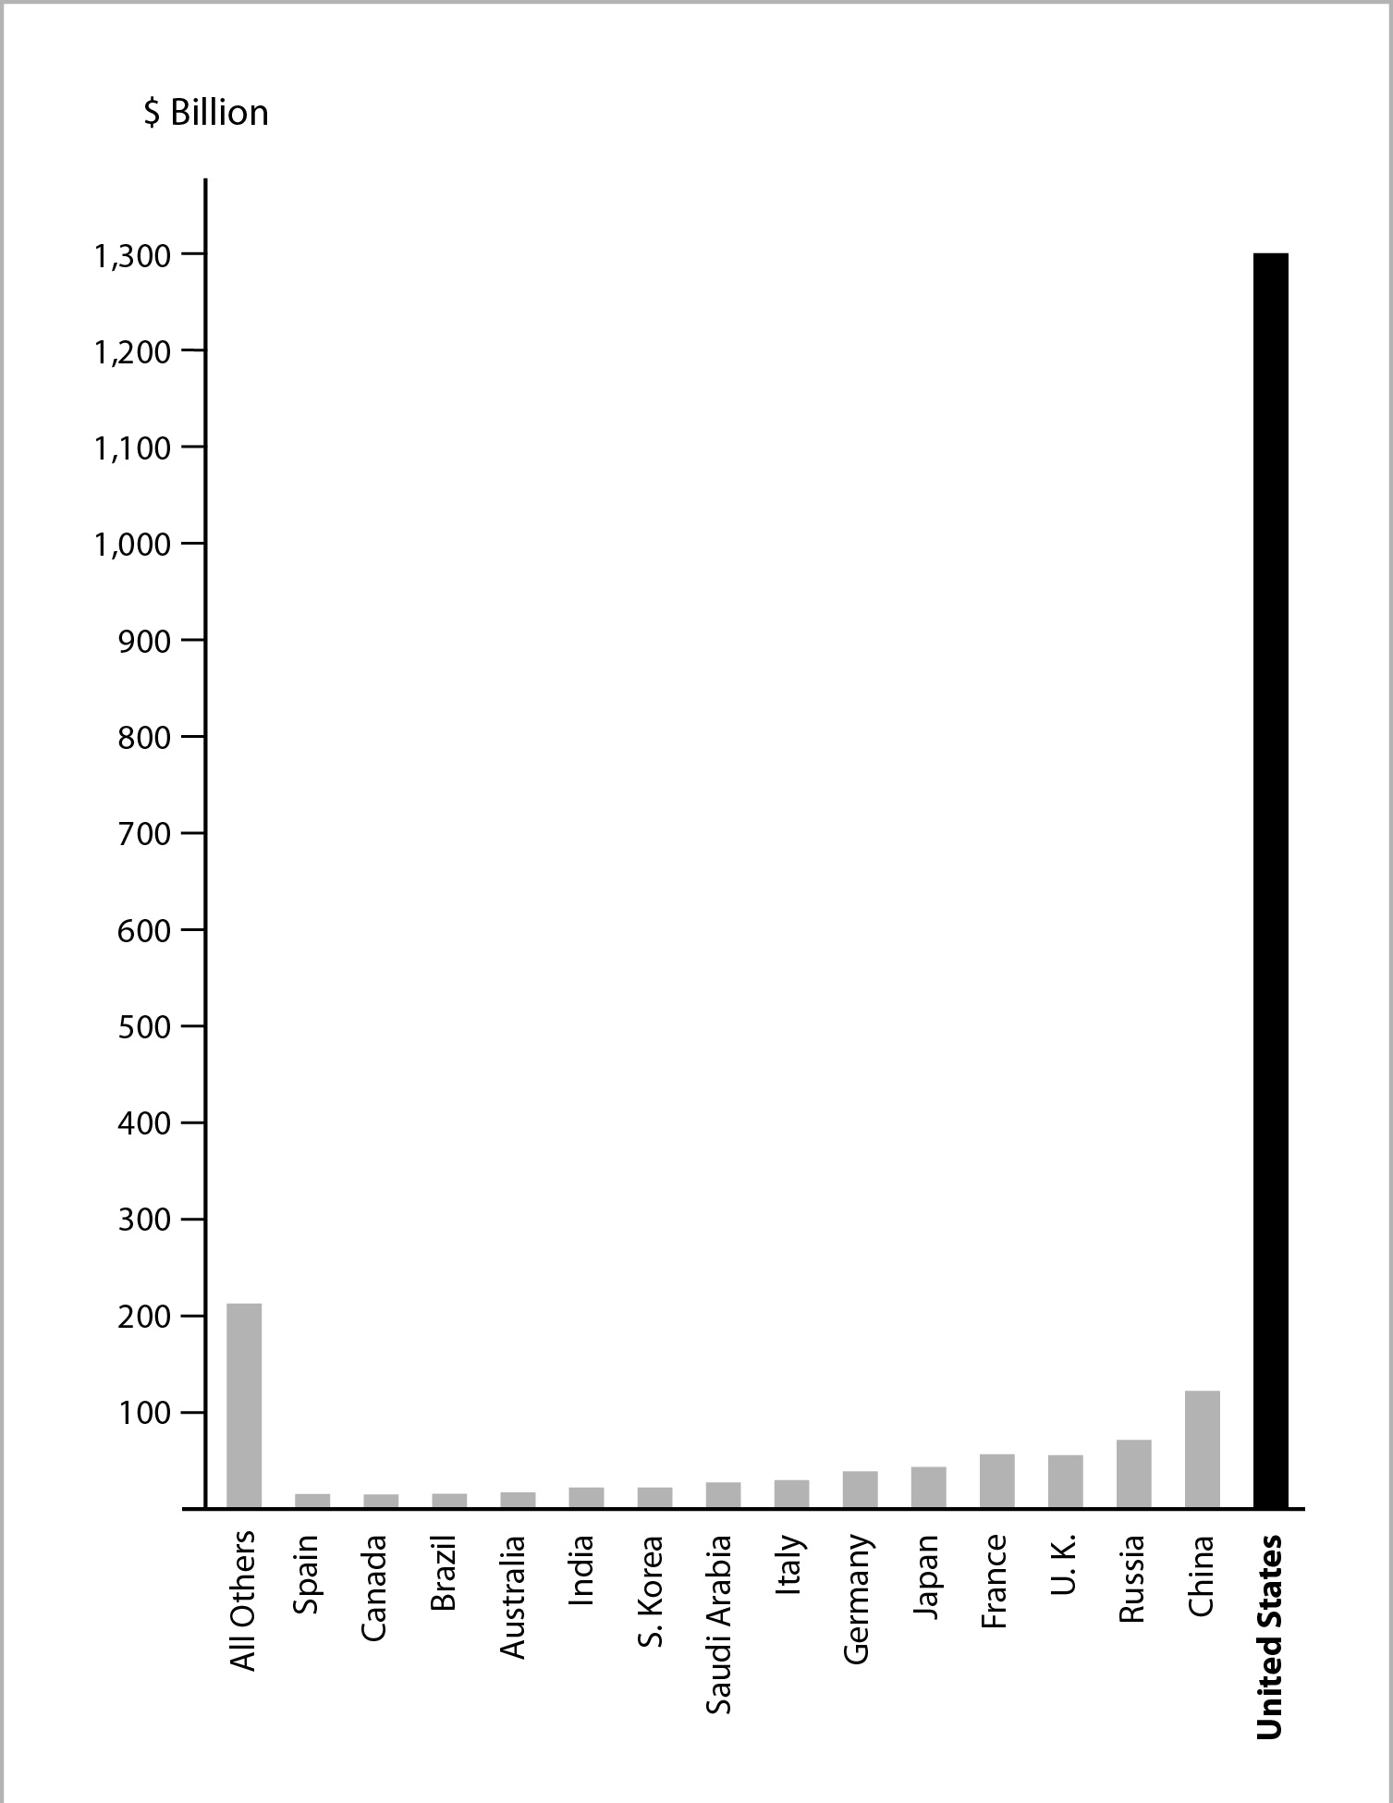
The Military Budget is Killing Us
Breakout Comparison
Notes:
Agriculture, Education, Health
Russia, Great Britain, France
How many foreign military bases? Russia-Syria, England-Falkan Islands, China-0

Slide 11
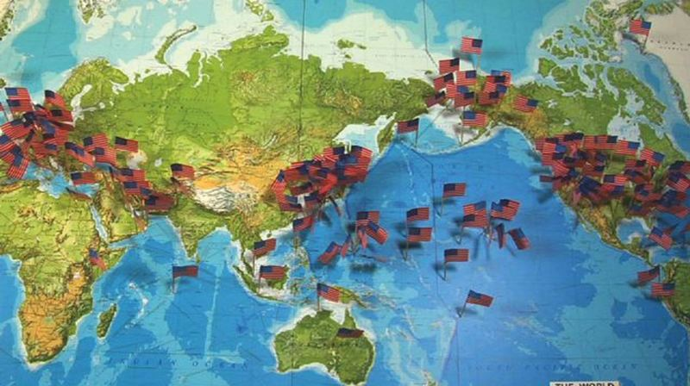
1,000 US Foreign Military Bases

Slide 12
If Cut Military Budget in Half Over 10 Years
$1.3 Trillion x 50% x 10 = $6.5 Trillion
$2.5 Trillion: Social & Greening programs
$2.5 Trillion: Reduce Global Poverty
$1.5 Trillion: Tax Cuts/Reduce National Debt

Slide 13
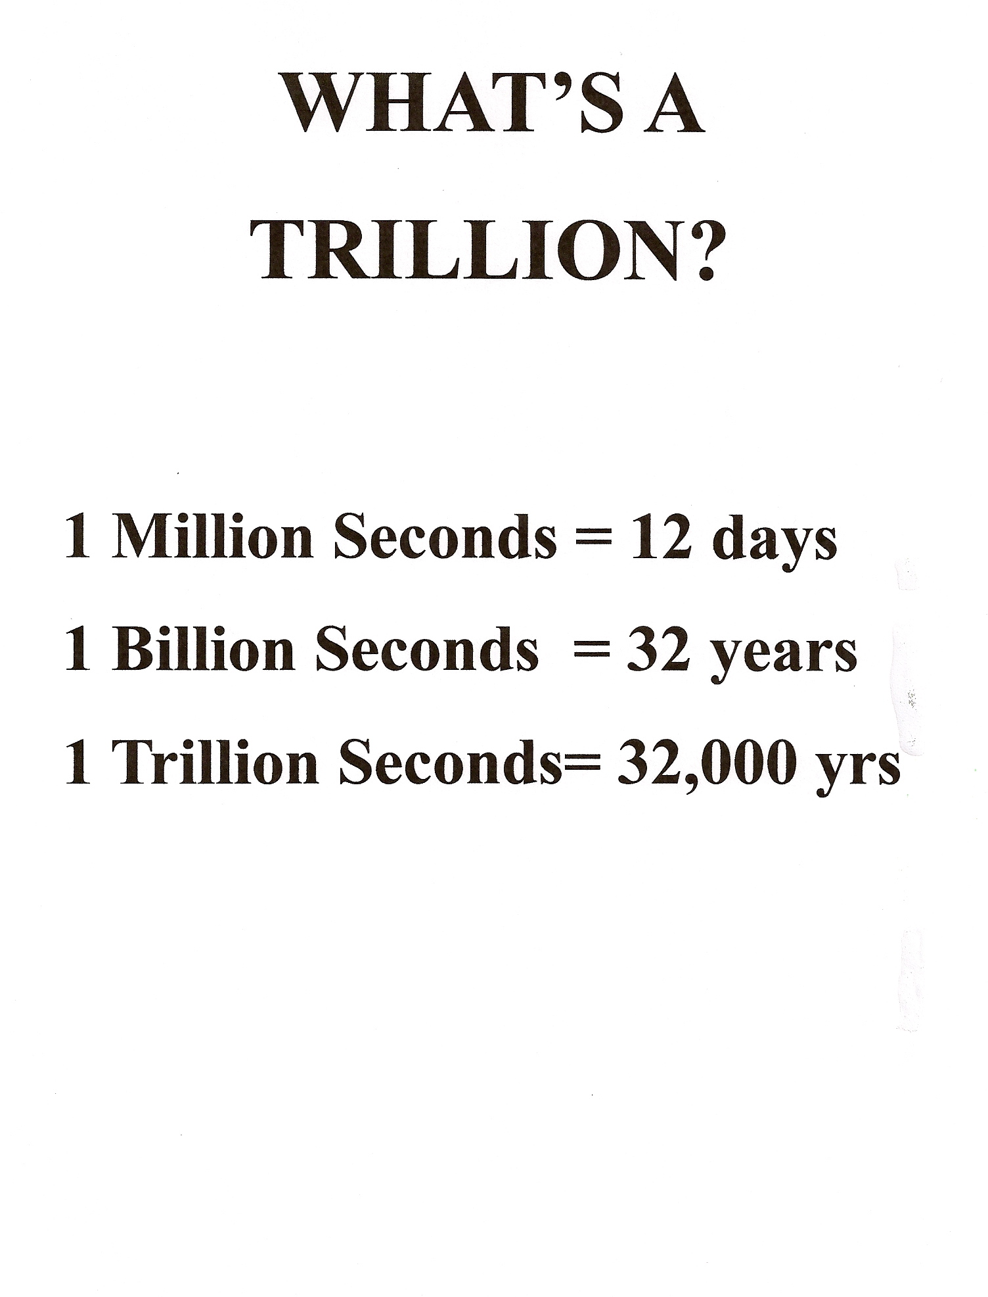

Slide 14
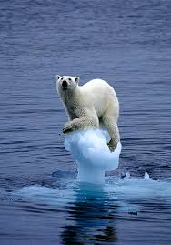
AHA #4 Collapse
Notes:
System is so flawed that we may not have to tear it down.

Slide 15
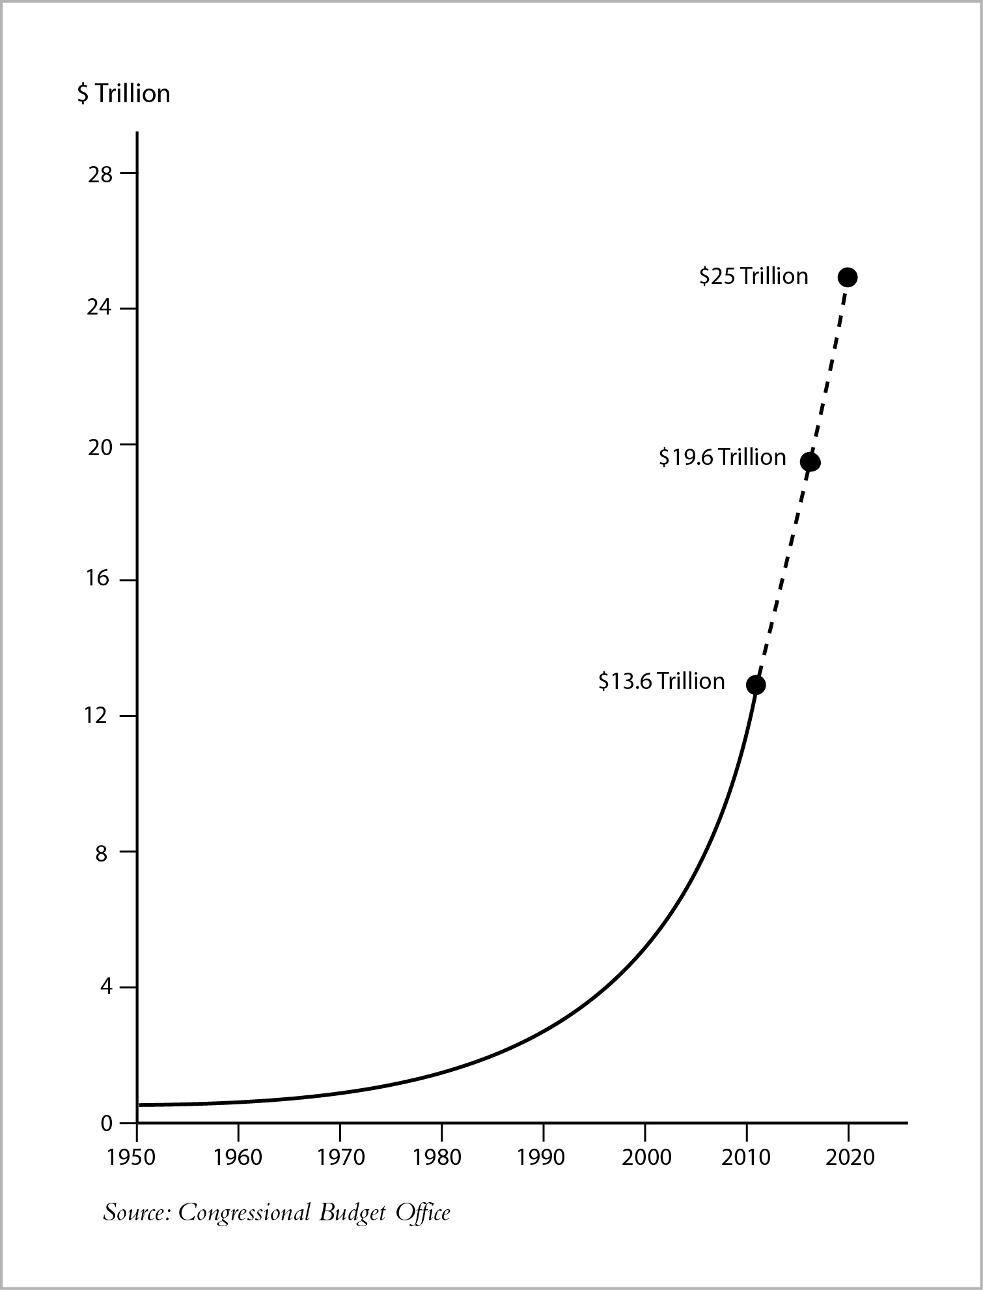
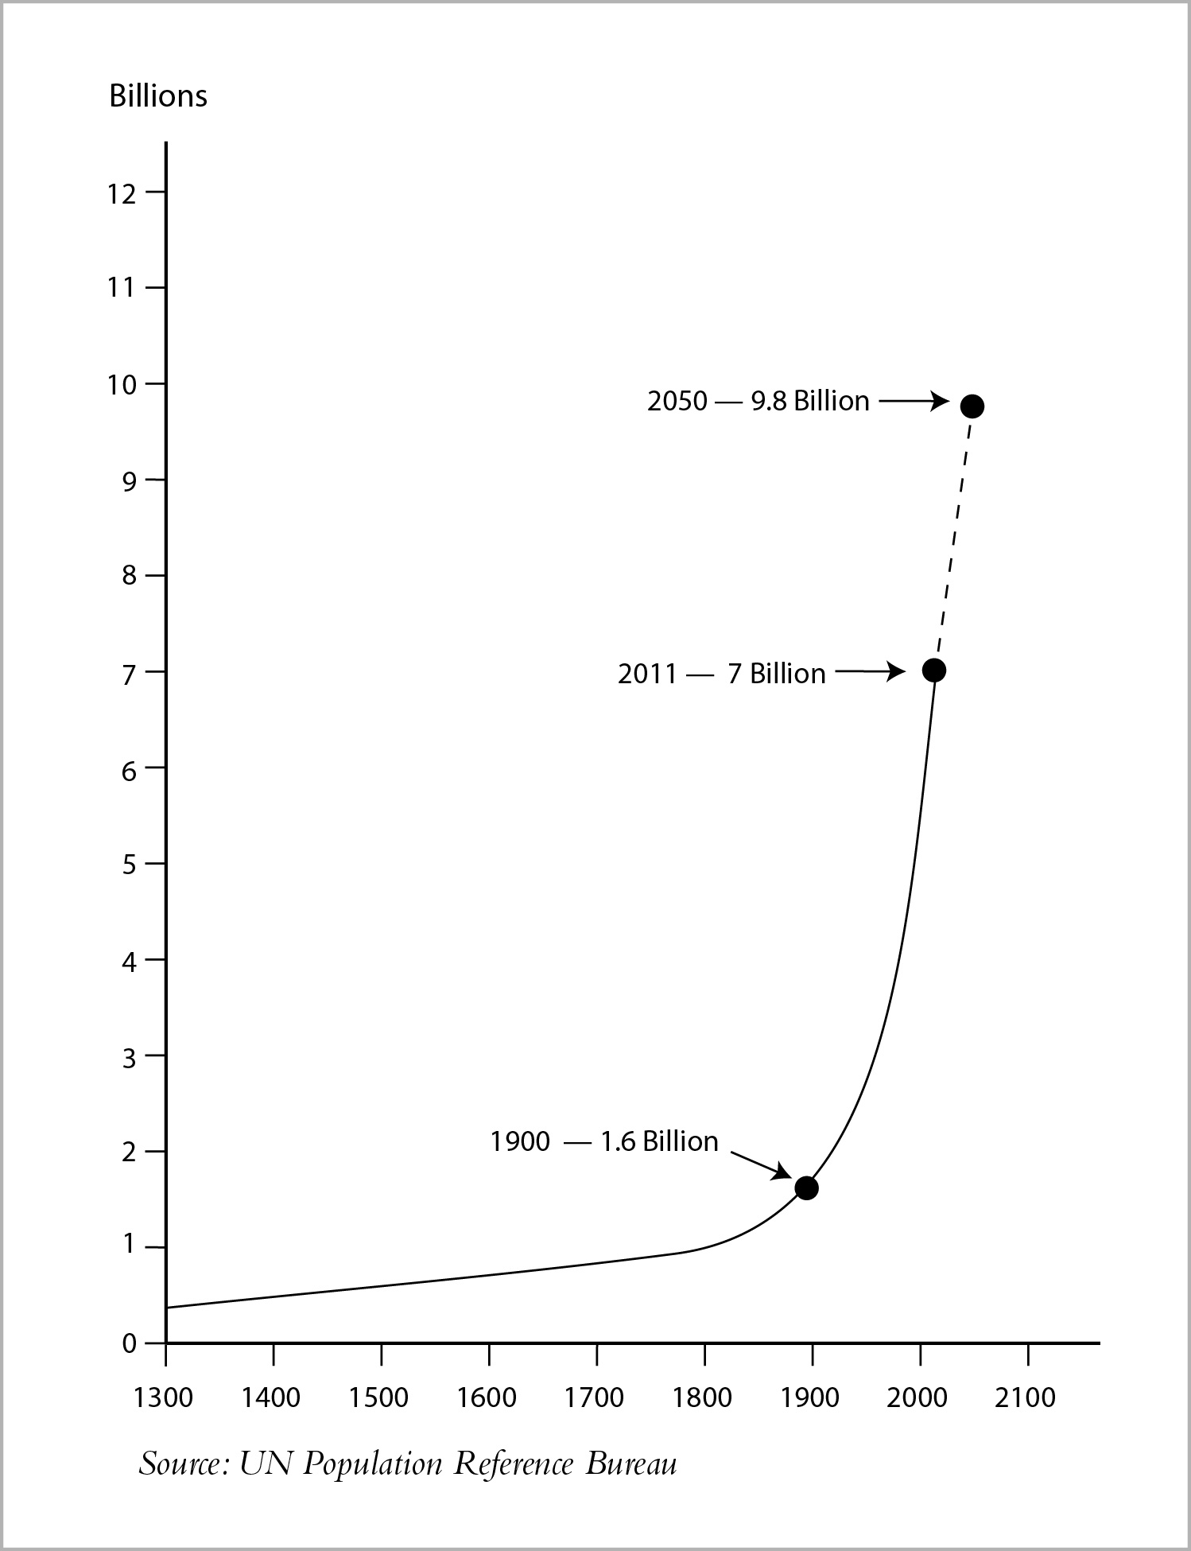
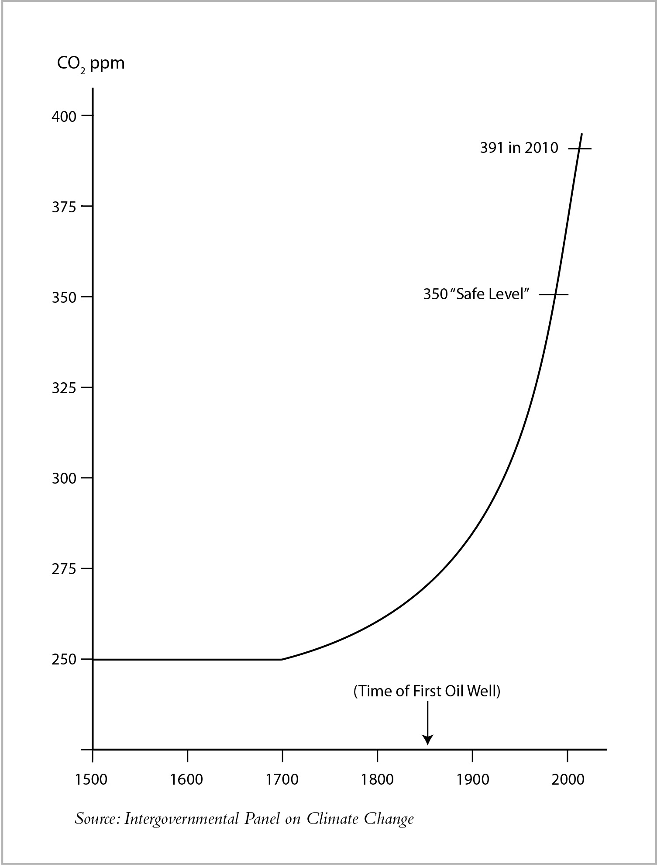
Exponential Growth z[p Population CO2 National Debt
Notes:
Exponential. 1.6 B/1900, CO2, Debt, Peak Oil
All this led me to a concept of a more peaceful national security policy. DRINK WATER. So let’s start with a defintion…

Slide 16
Peak Oil

Slide 17
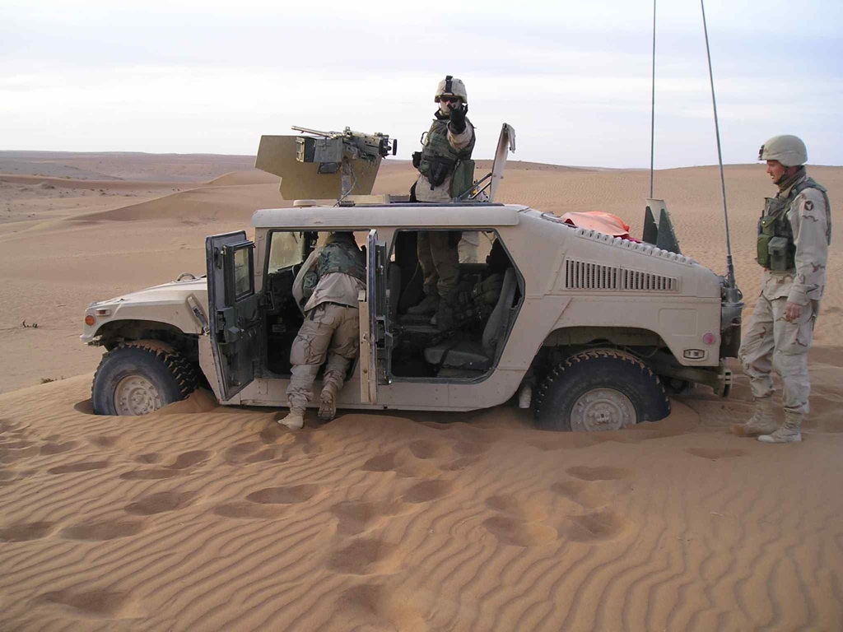
Where We’re Stuck
Notes:
----- Meeting Notes (2/16/14 11:37) -----
We don't know what peace is
We don't think it's possible
We don't know how to do it

Slide 18
Part 2 World Beyond War
A Global Movement to End All Wars

Slide 19
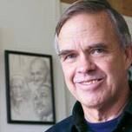
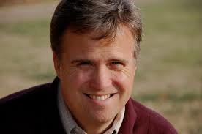
ENDING ALL WAR: An Idea Whose Time Has Come – For our Children and All Future Generations
September 15, 2013
. …Your feedback on the overall idea and for strengthening the proposal would be most welcome.
David Swanson
David Hartsough

Slide 20
Declaration of Peace
…I commit to engage in and support nonviolent efforts to end all war and preparations for war and to create a sustainable and just peace.
3,000 people, 200 organizations

Slide 21
Structure
International Team of Leading Peace Activists
Serve as a Hub
Constructive & Obstructive NV
September 21, 2014 Launch

Slide 22
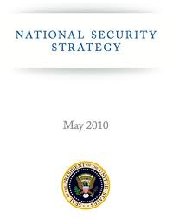
Alternatives to War
Security – There is a better plan
Economics - Money can be
better spent
Cultural – From a culture of war
to a culture of peace

Slide 23
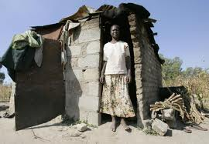
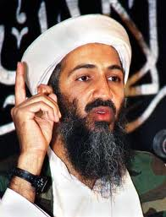
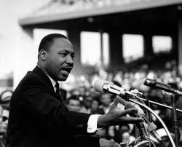
Core Peace Principles
Commit to the Well-being of All
Protect Everyone, Even Our Adversaries
Use Moral Rather Than Physical Force

Slide 24
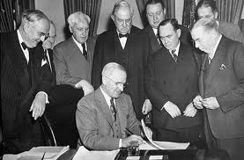
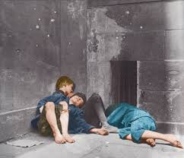
Alternative 1- Global Marshall Plan
Model: WWII Marshall Plan
Goal: Prevent war
Strategy: Eliminate global poverty
Theory: Society is less of a threat

Slide 25
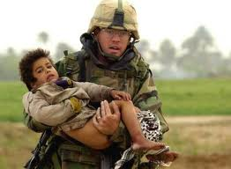
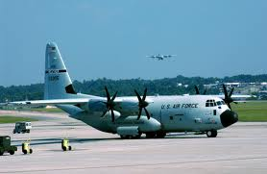
Alternative 2 – Transform the Military
Soldiers want to serve
Humanization Boot Camp
Implement the GMP
Gradual Transition

Slide 26
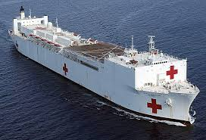
Alternative 3 – Convert the Defense Industry
WWII Industrial Conversion
Steer the work
Subsidize the transition
Increased employment

Slide 27
Part 3 Is Peace Possible?

Slide 28
Possible Change Path
Notes:
Transformational Event. Paul Krugman. Humans need a crisis. Pentagon rethinks.
Suffering: institutional collapse, global depression, mass human migrations, starvation

Slide 29
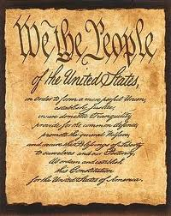
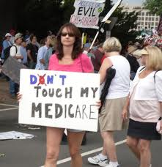
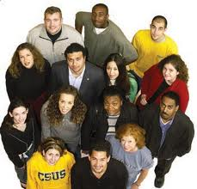
Reasons for Optimism
Notes:
All men created equal. Life, Lib., Pursuit of Happ Dissatisfaction w government – expensive, Leadership in business, government, military.
Least materialistic, most open to change.

Slide 30
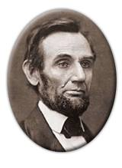
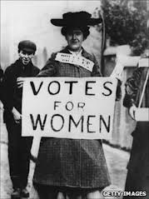
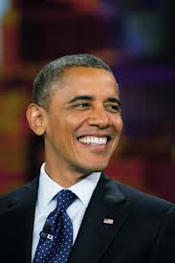
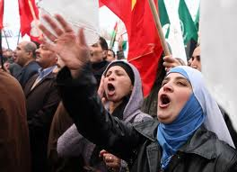
Major Change Can Happen
Notes:
13th Amendment in 1865, women 1920
Black 2008, Arab Spring began in 2010

Slide 31
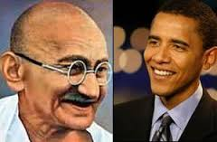
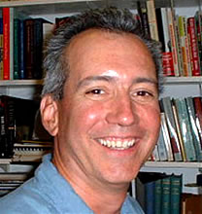
Change from the Bottom Up

Slide 33
Thank You!
www.worldbeyondwar.org
www.transitiontopeace.com

